Slide 1



Sentimental Detection Analysis
ManiDeepak P - 190137

Slide 2


maniDeepak P - 190137
01
Objective of SDA

Slide 3
maniDeepak P - 190137
The main goal of SDA is to improve the human-machine interaction.
It may also be utilized in lie detectors for examine a person's psychological and physiological situation.
Leading the way in objective speech testing for clinical trials and healthcare research is speech analytics.
Speech analytics for the pharmaceutical sector.

Slide 4
maniDeepak P - 190137
02
Introduction of
SDA

Slide 5
maniDeepak P - 190137
The aim of Sentimental Detection Analysis in audio (SDA) is to recognize the emotional elements of speech, regardless of the semantic content. While people can do this activity efficiently as a natural component of voice communication, the capacity to do so automatically using programmable devices is currently under investigation.

Slide 6


maniDeepak P - 190137
03
Methodology used in SDA

Slide 7
maniDeepak P - 190137
The model takes input from the file which is already present.
The proposed system extracts features like Mel-Frequency, Cepstral Coefficients (MFCC), chroma, and mel spectrogram from the audio which were used as the input to the MLP classifier model.
The MLP classifier has been used in this proposed system to train and predict emotions like calm, happiness, fearfulness and disgust.
The proposed system can also predict the emotions on a recorded audio file using py audio library and then the feature extraction and prediction is performed

Slide 8
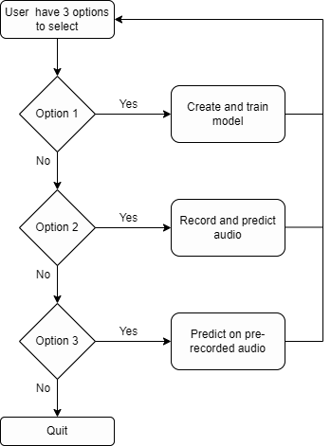
maniDeepak P - 190137
Flowchart of working

Slide 9
maniDeepak P - 190137
04
Results

Slide 10
maniDeepak P - 190137
Maximum accuracy given by following classifiers/ML Techniques
IEMOCAP 73.00%
CNN SVN 70.00%
GAN 46.52%
SVM 60.80%
FAU AIBO 54.10% RAVDESS/LMT 70.00% RAVDESS with MLP (used) 78.65%

Slide 11
maniDeepak P - 190137
SDA is a very fascinating and popular area for computer science study. The suggested system employs a fine SDA algorithm with recognition and a be accuracy of 76.56 percent.
The suggested method can be expanded in the future to conduct emotion recognition on multilingualism.
Furthermore, it may be developed to discern emotions at a finer level in relation to the surroundings.
05
Conclusion

Slide 12

maniDeepak P - 190137
Thank you :)

